Slide 1

Ideation Derby
Team Seven Subteam:
Kismet Crossdale, Hayden Fuller, Jameson Giannattasio

Slide 2


Problem Statement + Design Criteria
Problem Statement
Goal: To design a device that reduces time and labor of cleaning solar panel in the absence of rain; through cleaning, will increase the solar panel efficiency
Design Criteria
Affordability - less than $100 USD
Easy to Install - can install within 30 minutes
Energy Output - consistent source of energy
Longevity - lifetime of solar panel increases by 10 years

Slide 3
Concept Generation Process
Step 1
Step 2
Step 3
Step 4
Step 5
Clarify the Problem
Search Externally
Search Internally
Explore Systematically
Reflect on Solutions & Processes

Slide 4
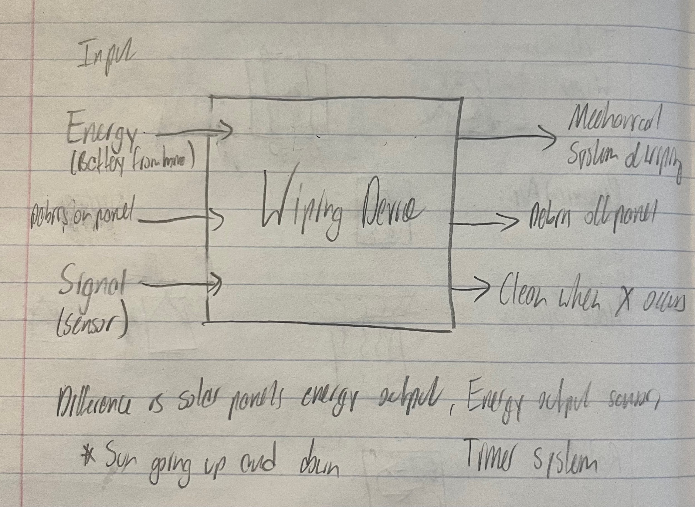
Step 1: Clarify the Problem
Pictured to the left: Black box diagram

Slide 5
Step 2: Search Externally
Competitive Product | Patent Number | Title/Description | Relation to the Project
Pleco Solar | Based on Bar-Ilan University Patents Patent Pending? | Robot Solar Panel Cleaner | Concept for brushing debris off Rotating brush (robot does not use water)
Straight Sweep Windshield Wiper | US4245369A | Wiper arms | Concept for the movement of the wiper
iRobot Roomba | US9883783B2 | Debris detection | Concept for detection of when to clean the panel.
3 Related Patents:
Pleco Solar
Robot w/ rotating brush
Doesn’t utilize water
Too expensive
Straight Sweep Windshield Wiper
Efficient motor arm
iRobot Roomba
Excellent debris detection

Slide 6
Pleco Solar (Brushing)
Pros:
Little to no water use
Ease of application
Cleaning efficiency
Cons:
Expensive (>$100 USD)
Not simplistic in design
How it influenced the concept selection and generation process:
Realized importance of device not using any water/cleaning solution to bring down cost
Metric | Importance | Score
No Water Use | 4 | 5
One-Time-Purchase | 5 | 4
Cost | 4 | 1
Easy-to-Use | 4 | 5
Brushing Debris | 5 | 5
Simplicity | 5 | 2
Compatibility with panels | 4 | 4

Slide 7
Straight Sweep Windshield Wiper
Pros:
Efficient in motion ability
Length
Simplicity in design
Cons:
Blades are not the entire length of wiper arm
How it influenced the concept selection and generation process:
Length of blade & wiper arm
Rotational motion
Metric | Importance | Score
Motion efficiency | 4 | 4
Long length | 4 | 3
Blades are whole of wiper arm length | 4 | 1
Motor driven arm | 5 | 4
Simple design | 5 | 4
Low cost | 5 | 3
Durability | 5 | 4

Slide 8
Roomba Dirt Detect
Pros:
Inability to be impeded by debris
Durability
Cons:
Not low cost (>$100 USD)
How it influenced the concept selection and generation process:
Realized importance of specificity of sensor
Detection style of sensor
Metric | Importance | Score
Doesn’t clog up | 5 | 4
Low cost component | 4 | 3
Piezoelectric sensor | 3 | 5
Durable | 5 | 4
Detects instantaneously rather than build up | 3 | 5

Slide 9
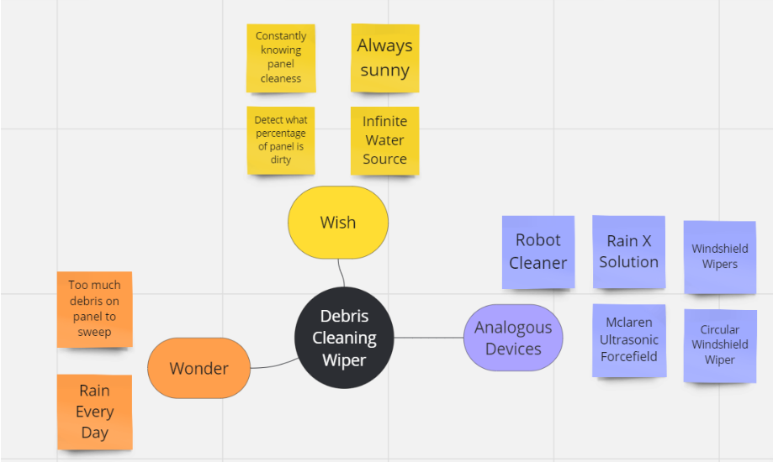
Step 3: Search Internally
Utilized ideation templates such as Miro
Generated concepts using personal knowledge/creativity
Brainstorming:
Wish and Wonder
Identify boundaries of problem
Analogous Devices
Recognize similar solutions

Slide 10
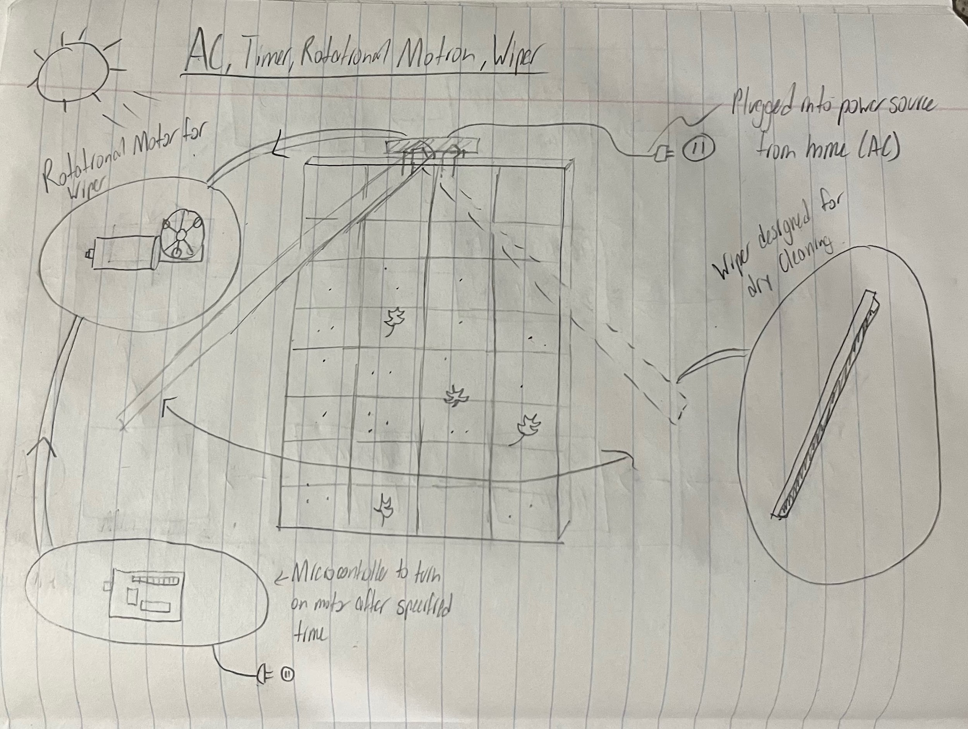
Step 4: Explore Systematically
Store/Accept External Energy:
Battery
Directly from solar panel
AC power
Triggering/Sensing Debris:
Light detector
Solar Efficiency
Timer
Manually triggered
Energy to Debris:
Rotational motor connected directly to blade (Windshield)
Belt driven pulley system (Horizontal)
Air/Water/Other liquids
Most Promising Methods:
Store/Accept External Energy | Triggering/sensing debris | Energy to Debris
AC power | Timer | Rotational motion
Battery | Efficiency calculation | Linear motion
Sketch of 1st promising method

Slide 11


Step 5: Reflections on Solution & Process
Fully Explored Solution Space
Alternative function diagrams & problem decomposition
Sub functions & systems were entirely fleshed out
Black box diagram
Energy, Materials, & Signals framework
Ex: functional block diagram, circle diagram
We believe that the diagrams & frameworks we used (named above) were most efficient in decomposing the problem

Slide 12





Step 5 (Cont.)
External sources
Collective brainstorm & integrated ideas
Each member picked a different patent to explore
Kismet: Straight Sweep Windshield Wiper - blade design and motion
Hayden: iRobot Roomba - sensor and detection abilities
Jameson: Pleco Solar - waterless solution & solar panel compatibility
Aspects welcomed & blended into final design
AC power + Efficiency sensor + Wiper with Rotational Motion
Chose patents most relevant to device due to similarities in subsystems & functions

Slide 13
Concept Screening
Selection Criteria:
Cleaning Effectiveness
Detection Efficiency
Durability
Low Cost
Motion Efficiency
Simplicity
Ranked with +,-,0 system
 | Concepts
 | A Straight Sweep Windshield Wiper + manual (Reference) | B AC Power + Timer Sensor + Rotational Motion | C Battery + Efficiency Calculation Sensor + Linear Motion | D Ultrasonic Vibration Force Field | E Circular Windshield Wipers
Net Score | 0 | 3 | -1 | -1 | 2
Rank | 3 | 1 | 4 | 4 | 2
Continue? | Revise | Yes, Combine | Yes, Combine | No | Yes
C had best Detection
Combine with highest overall rank (B)
Notes:
Hayden

Slide 14
Decision Matrix
 |  | Concepts
 |  | A Straight Sweep Windshield Wiper |  | BC AC Power, Sensor, Rotational Motion |  | E Circular Windshield Wiper
Selection Criteria | Weight | Rating | Weighted Score | Rating | Weighted Score | Rating | Weighted Score
Durability | 15% | 3 | .45 | 4 | .6 | 4 | .6
Motion Efficiency | 15% | 3 | .45 | 4 | .6 | 4 | .6
Low cost | 20% | 3 | .6 | 3 | .6 | 4 | .8
Simplicity | 15% | 3 | .45 | 3 | .45 | 4 | .6
Cleaning Effectiveness | 20% | 3 | .6 | 3 | .6 | 2 | .4
Detection Efficiency | 15% | 3 | .45 | 5 | .75 | 2 | .3
Total Score Rank |  | 3 3 |  | 3.6 1 |  | 3.3 2
Continue? |  | No |  | Develop |  | No
Combined B and C
AC Power, Efficiency Sensor, Rotational Motion
Weight of selection criteria determined by importance to users and product
BC had highest score
Notes:
Hayden

Slide 15
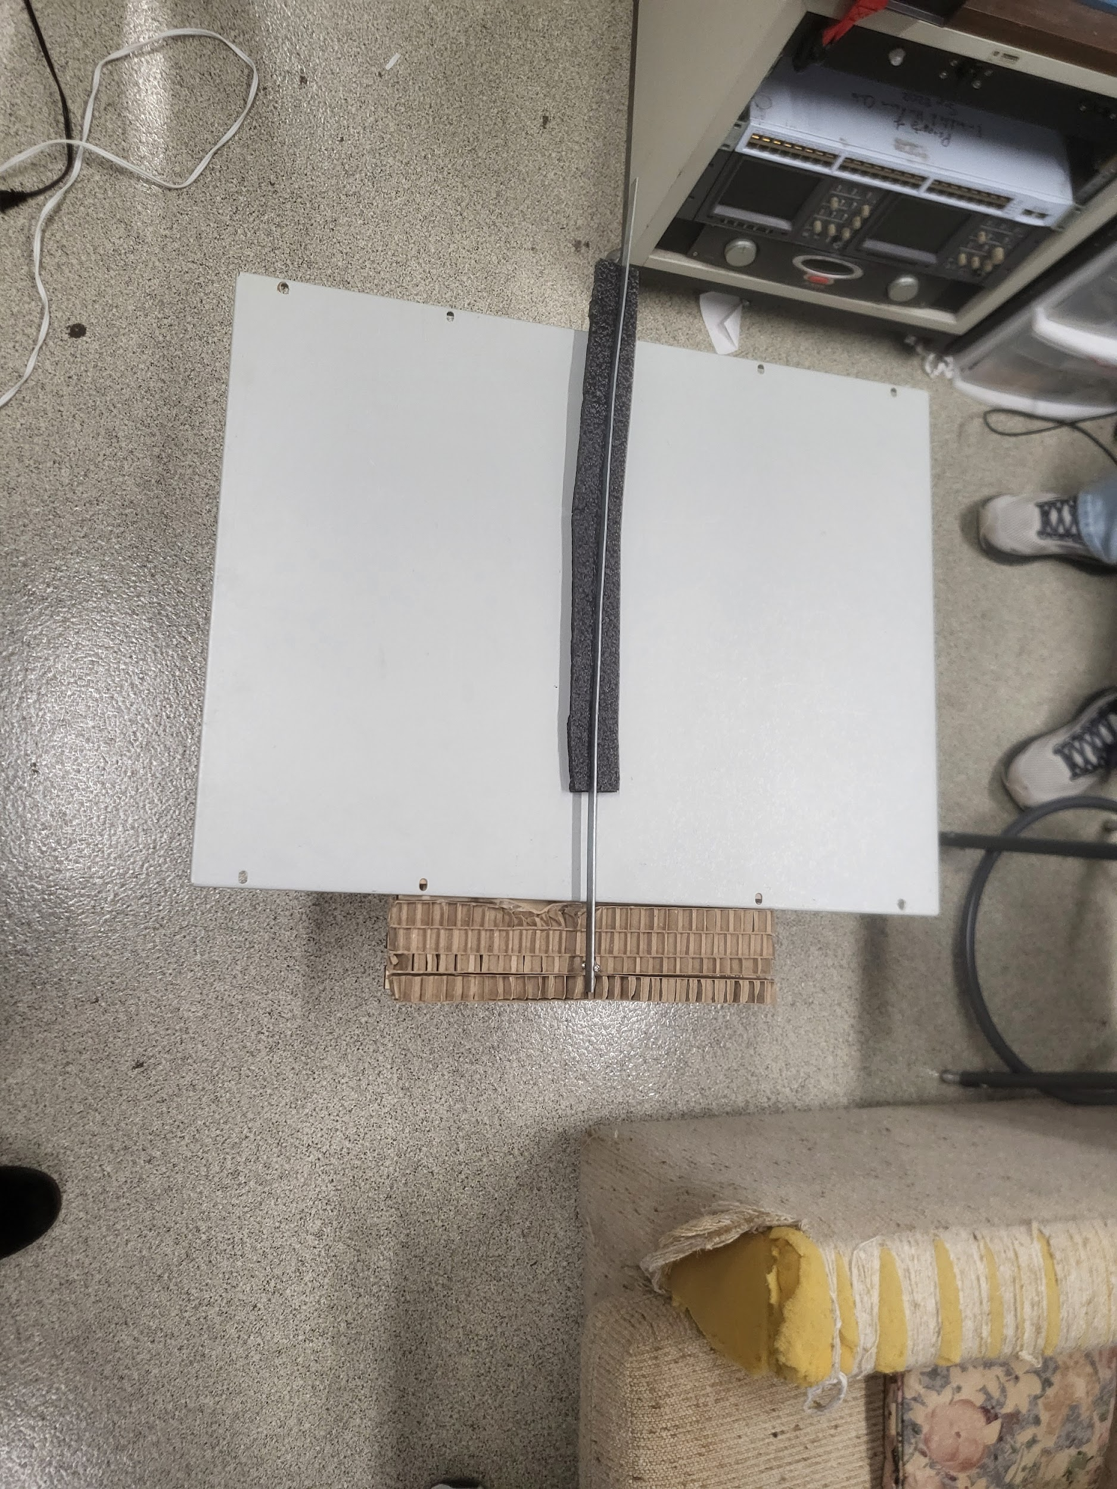
Low-Fidelity Prototype
Functions and Materials:
Solar Panel
Metal Sheet
Wiper
Metal Blade
Foam
Bolt
Mounting Apparatus
Wood
Cardboard
Notes:
Hayden

Slide 16
Conclusion
Through the ideation process, a solution was collectively devised by our subteam that meets the design criteria:
Proposed solution concept
Rotational wiper powered by AC source with an efficiency sensor
Benefits of concept
Detects debris effectively
Efficiently removes all debris to increase energy output
Minimal parts to keep simplistic, affordable, and easily installable

Slide 17
Questions?

Slide 18
Citations (IEEE)
[1] “Product Pleco Solar” Blade Ranger. Accessed February 12, 2024. [Online]. Available: https://bladeranger.com/pleco/
[2] “Straight Sweep Windshield Wiper” Google Patents. Accessed February 12, 2024. [Online]. Available: https://patents.google.com/patent/US4245369A/
[3] “Debris Sensor for Cleaning Apparatus” Google Patents. Accessed February 12, 2024. [Online]. Available: https://patents.google.com/patent/US20170202419A1/
[4] All Images courtesy of Kismet Crossdale, Hayden Fuller, and Jameson Giannattasio or Microsoft Powerpoint Stock Image, Icon, and Illustration Library.

